Slide 1

A6:_| Med-Fi_|_
Prototype
Team 2:
Alexander Yue
Evan Hsu
Diego Valdez Duran
Ecem “AJ” Yilmazhaliloglu

Slide 2
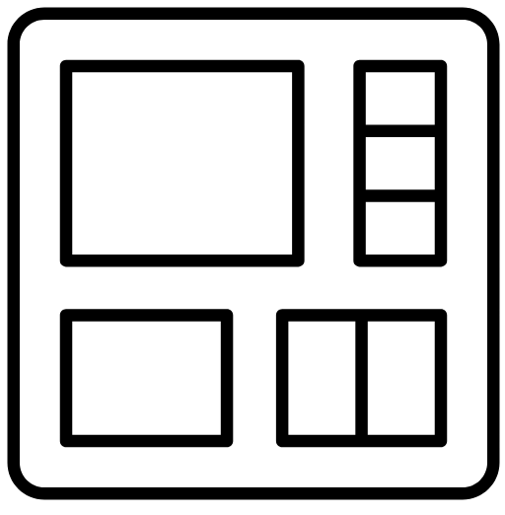
01
PROBLEM

Slide 3

Primary User and their problem
Our interviews revealed that many us undergraduate students use collaboration as a study tool for academic success, but often find the formation, scheduling, and planning of such groups quite difficult.

Slide 4
02
SOLUTION OVERVIEW

Slide 5
Introducing:
Effortless, personalized study groups tailored to your schedule, preferences, and learning styles

Slide 6
How does work?
We collect information from students in classes and use AI enhanced tools paired with research on effective collaboration practices to automatically plan recurring study sessions and manage assignments
Notes:
HMW’s Generated: 1. HMW... make opening up to other students less confrontational?
2. HMW... encourage collaboration amongst students with similar academic goals?
3. HMW... make connecting with other students fun, welcoming and productive?
4. HMW make resources easier to share/create a culture of sharing?
5. HMW eliminate the fear of reaching out to other students and sharing resources?
6. HMW... help students how to navigate their applications more effectively?
7. HMW create a more welcoming space for high school students working on college applications?
8. HMW create a more transparent system to show students what college admissions officers look for in students?
9. HMW... gameify application processes so they are more rewarding?
10. HMW ensure students are equipped with the best college app resources without the need for peer interaction?

Slide 7
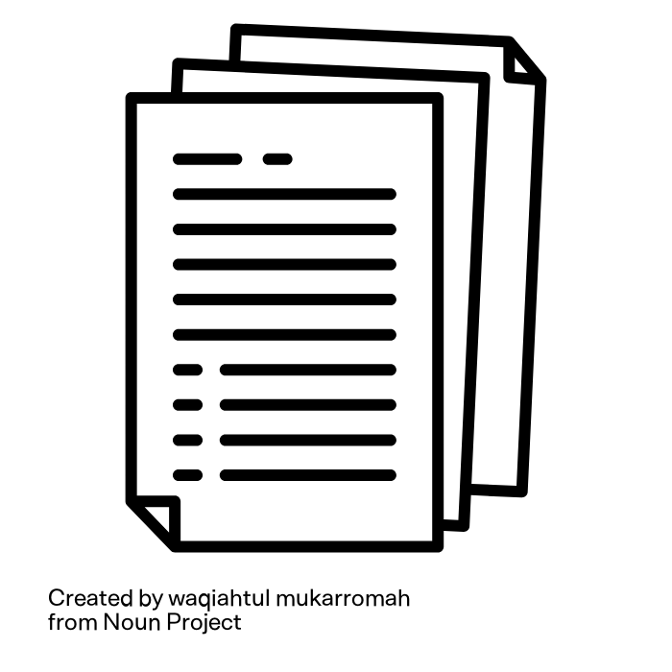

Research on Collaboration
Oyarzun, B., & Martin, F. (2023). A systematic review of research on online learner collaboration from 2012–21. Online Learning Journal, 27(3), 45-72. https://olj.onlinelearningconsortium.org/index.php/olj/article/view/3407
Loes, C. N. (2022). The effect of collaborative learning on academic motivation. Teaching & Learning Inquiry, 10(1), 37-52. https://journalhosting.ucalgary.ca/index.php/TLI/article/view/71910
Interview with Professor Granovetter, sociology professor at Stanford with nearly 200,000 citations

Slide 8
Key Takeaways
Systematic meta-analysis that shows correlation between collaborative activities and student motivation, engagement, and achievement in controlled online learning environments.
Uses data from 17 US undergraduate schools to show significant correlation between collaboration and academic motivation. Hypothesizes that presence of social factors in education reframes student’s mindset to take more active role in learning
Ideas about what survey questions to ask and how to match students.
Will be unpacked in full presentation on Monday

Slide 9




Competitor comparison matrix
Communities
Profile based matching
Education focus
Communication
Mobile app
Task management

Slide 10
The Problem
Our Solution
many us undergraduate students use collaboration as a study tool for academic success, but often find the formation, scheduling, and planning of such groups quite difficult
A centralized platform to foster academic partnerships with pre-planned and convenient study group sessions using preferences, schedules, and learning styles

Slide 11
03
VALUES IN DESIGN

Slide 12
Our Values
Reliable
Trustworthy
Inclusive
Intuitive
Users should have equal access to study resources and are matched with peers who support their learning goals
Discoverable study sessions, resources, and a clean interface that is easy to navigable
Ensure that proposed features support and keep up with students’ busy lives
Be transparent in what features may be considered for AI matching to build confidence in partnerships

Slide 13
Value-aligned Features
Reliable
Trustworthy
Inclusive
Intuitive
Public study sessions available to all students taking the class
create an inclusive and collaborative learning environment via norms and app values
Aim for equitable and diverse matches
Homepage showing all open study sessions and easily interpretable navigation tab
Recognizable icons and helpful ‘tutorial’ functionality
Sequential bite-sized steps for task flows
Login, discussion sessions, file uploads, and AI flows are consistent
Integration of these tools so users can spend less time on planning
Checkpoint summarizing all files that will be included in AI and during the pairing process
Requesting explicit consent
Transparency in features used in AI matching in dedicated space

Slide 14
Value Tensions
Trustworthy
Inclusive
Public study sessions may cause concerns if students feel uncomfortable sharing information or joining open groups
Balancing open access with user comfort may require visibility options for students
Matching diverse groups equitably might conflict with having explicit consent for matching conditions
Some users may wish to opt out of certain group dynamics

Slide 15

04
TASKS

Slide 16
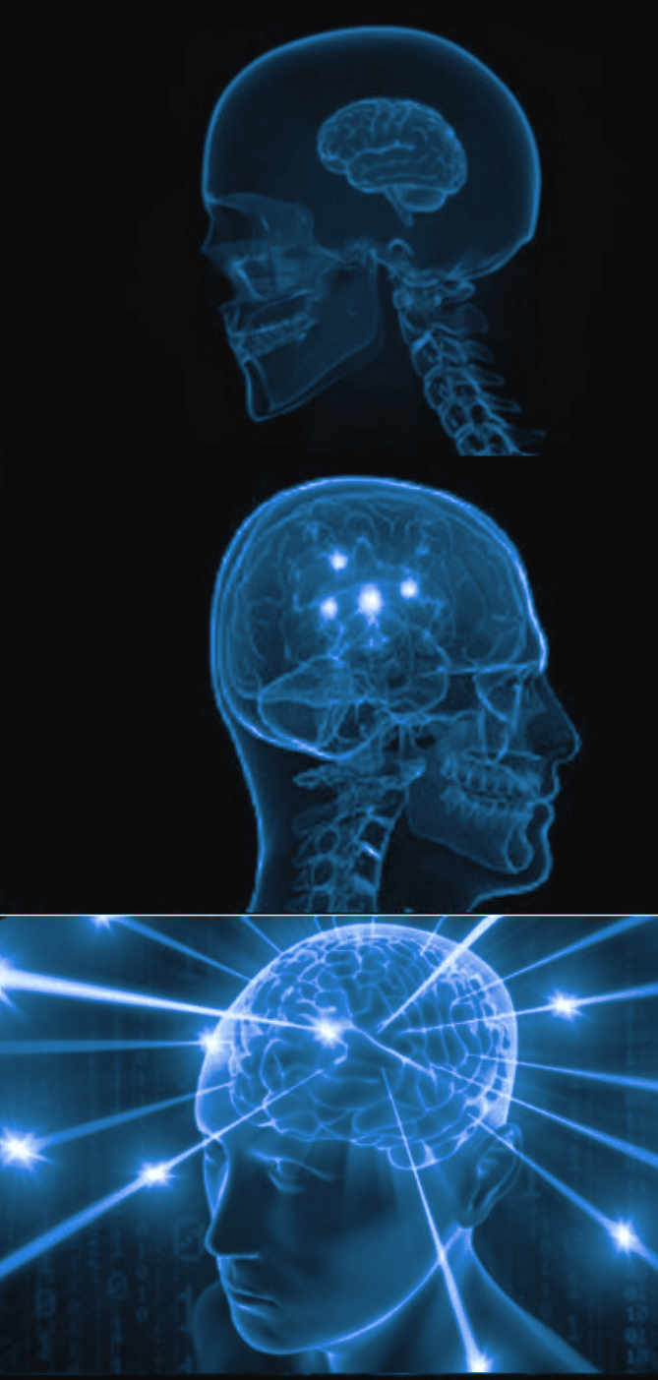
Slight simplification from A5
Simple
Discover public open study sessions for a class
Moderate
Upload class syllabi and assignments to get AI powered study plans
Complex
Create a study profile and get matched with recurring partners/study groups

Slide 17
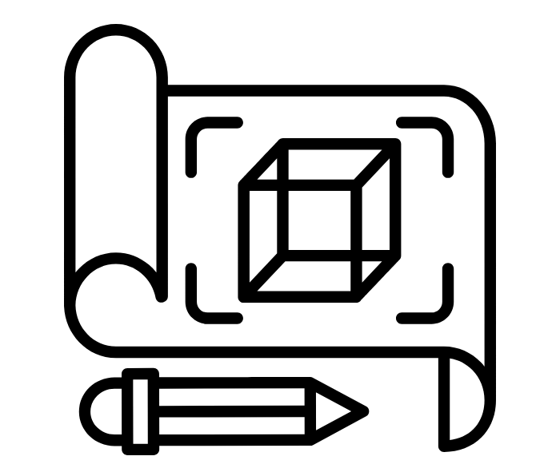
05
USABILITY GOALS AND
KEY MEASUREMENTS

Slide 18



Usability Goals
Efficiency- our app flow aims to minimize the number of steps required to complete key tasks
Error Prevention and Recovery- our app flow aims to mitigate misclicks and allow users to recover easily when they occur

Slide 19

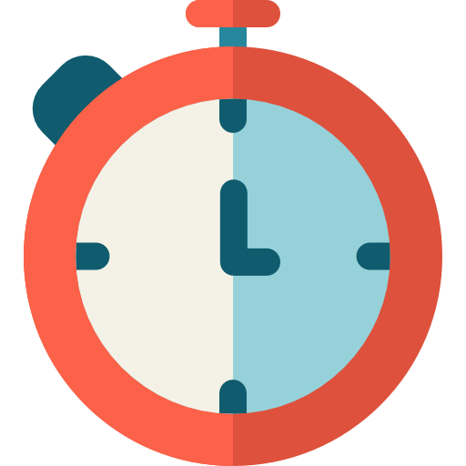

Key Measurements
Time to Complete a Task- we track the time it takes to complete each task from start to finish
Misclick Percentage- we count the number of misclicks for the duration of each task

Slide 20
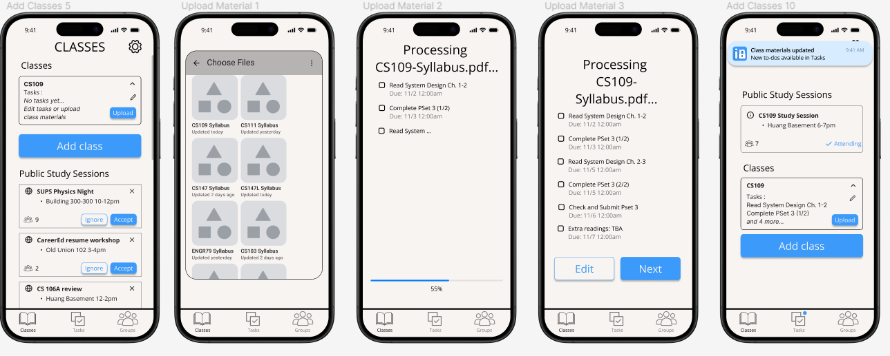
Product Progression - Goal 1: Efficiency
Clicks are only necessary for essential functions - minimal user interaction needed to complete a task
Open file selector
Choose file
Review and Submit
This improves our key metric 1: time to complete each task
Next steps:
Use hi-fi features like saved logins and file upload system to make user experience even easier

Slide 21
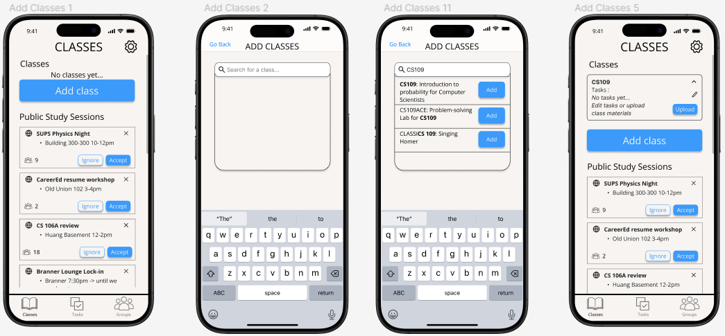
Product Progression - Goal 2: Error Handling
Added “Go Back” buttons to quickly return to previous screens
Tab bar consistently present to quickly navigate to task beginning screens This improved our key metric 2: minimize times user requires guidance to continue
Next steps (in progress)
Have users test figma and identity and clear up confusing patterns

Slide 22

06
SKETCH REVISIONS

Slide 23
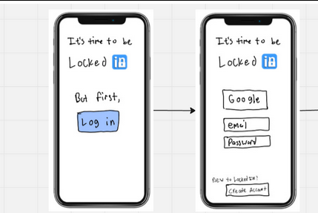
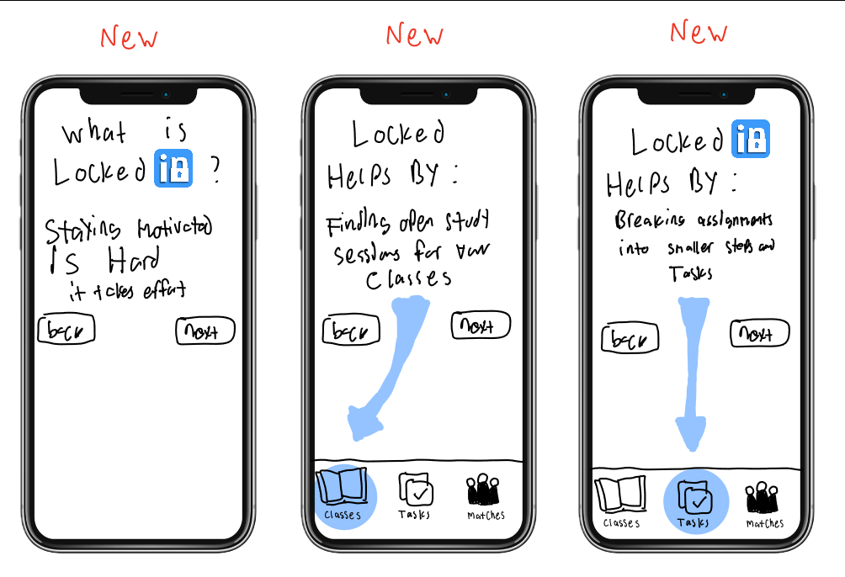
Revision 1: addition of onboarding pages

Slide 24
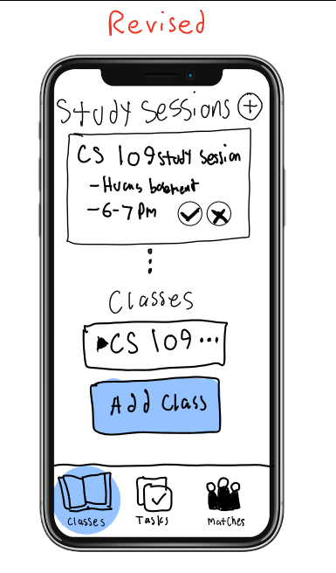
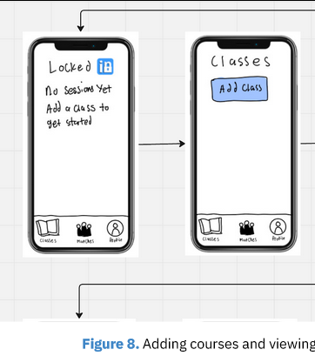
Revision 1: feed style for study sessions, viewable immediately

Slide 25
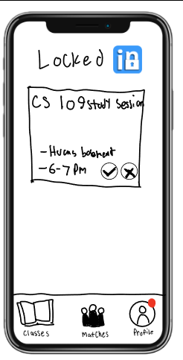
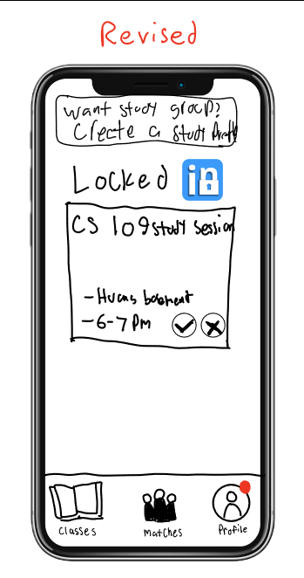
Revision 3: changed easily overlooked red dot to banner notification

Slide 26
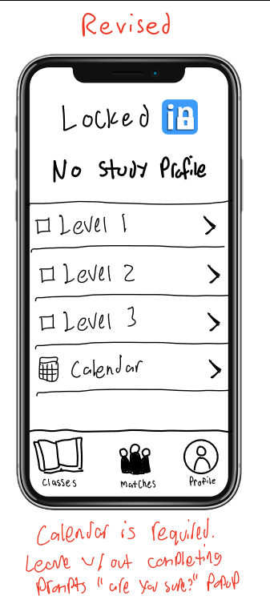
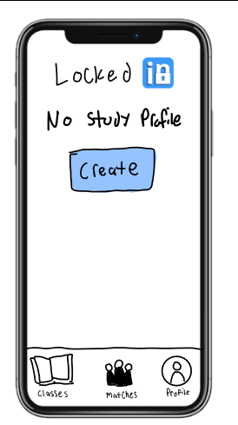
Revision 4: Allow users to put different levels of detail into their profile (not completed in med-fi yet)

Slide 27
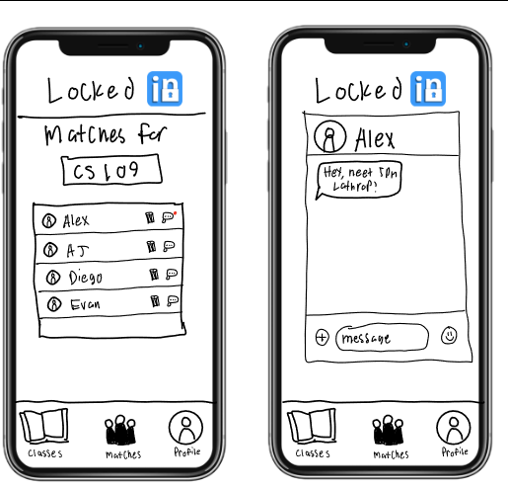
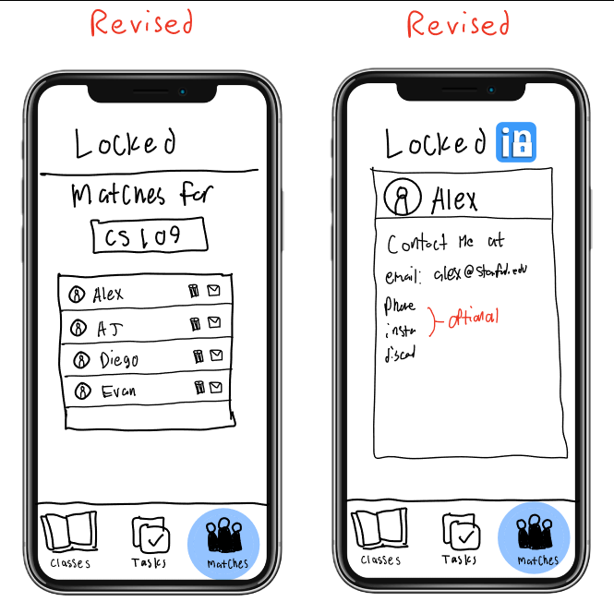
Revision 5: Remove in-app messaging, instead just give contact info

Slide 28
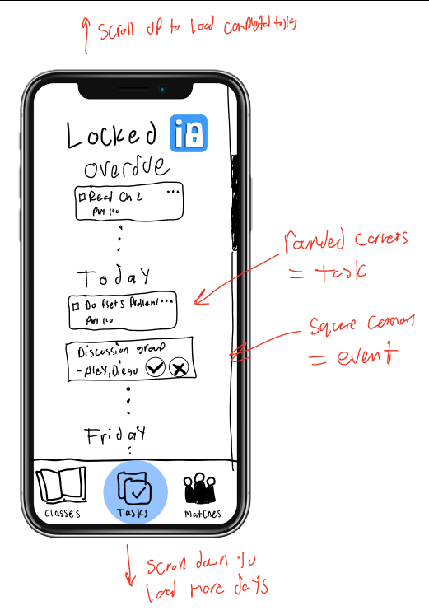
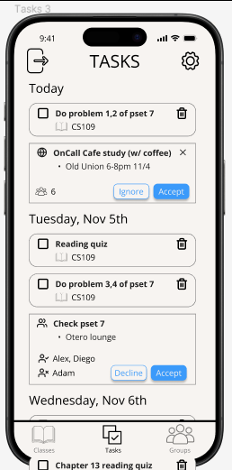
Major Addition: New tasks section which serves as feed-style homepage, listing tasks, group study sessions, & public study sessions

Slide 29
07
MED-FI TASK FLOWS

Slide 30
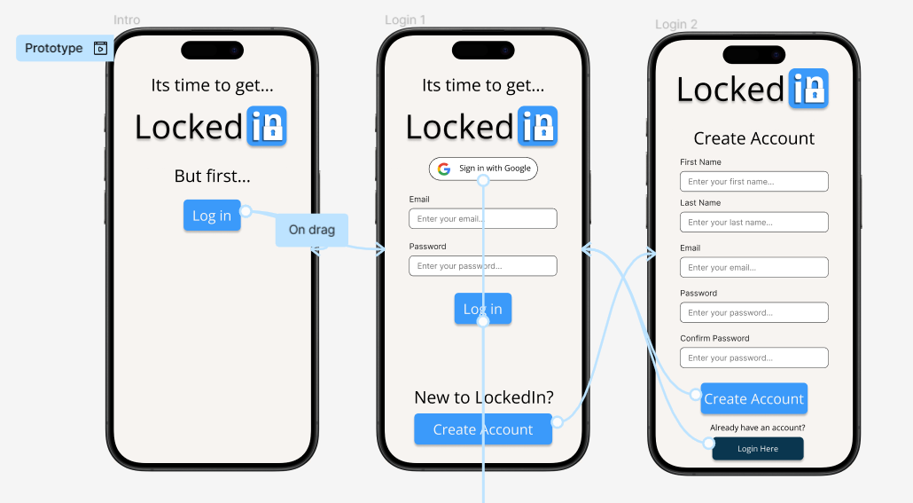
Task 0: Login/Register + Intro

Slide 31
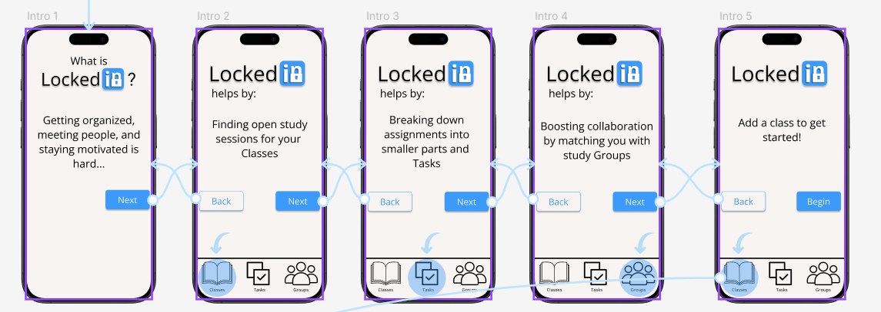
Task 0: Login/Register + Intro
We are addressing some of the confusion that lo-fi testers had by adding an overview on first app entry

Slide 32
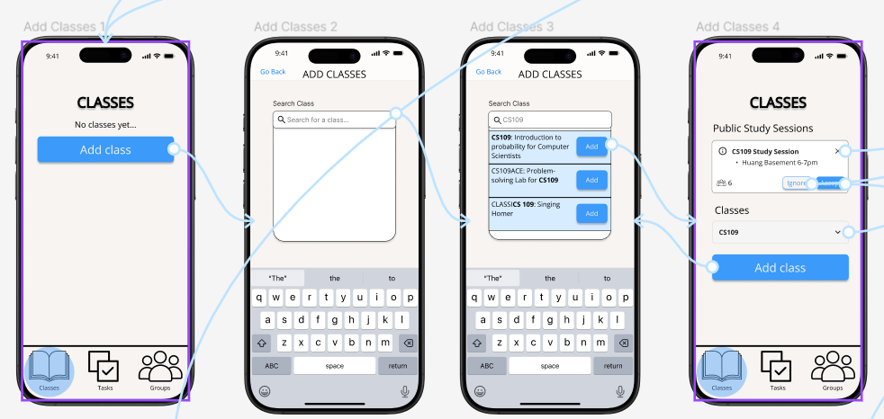
Discovering Study Sessions

Slide 33
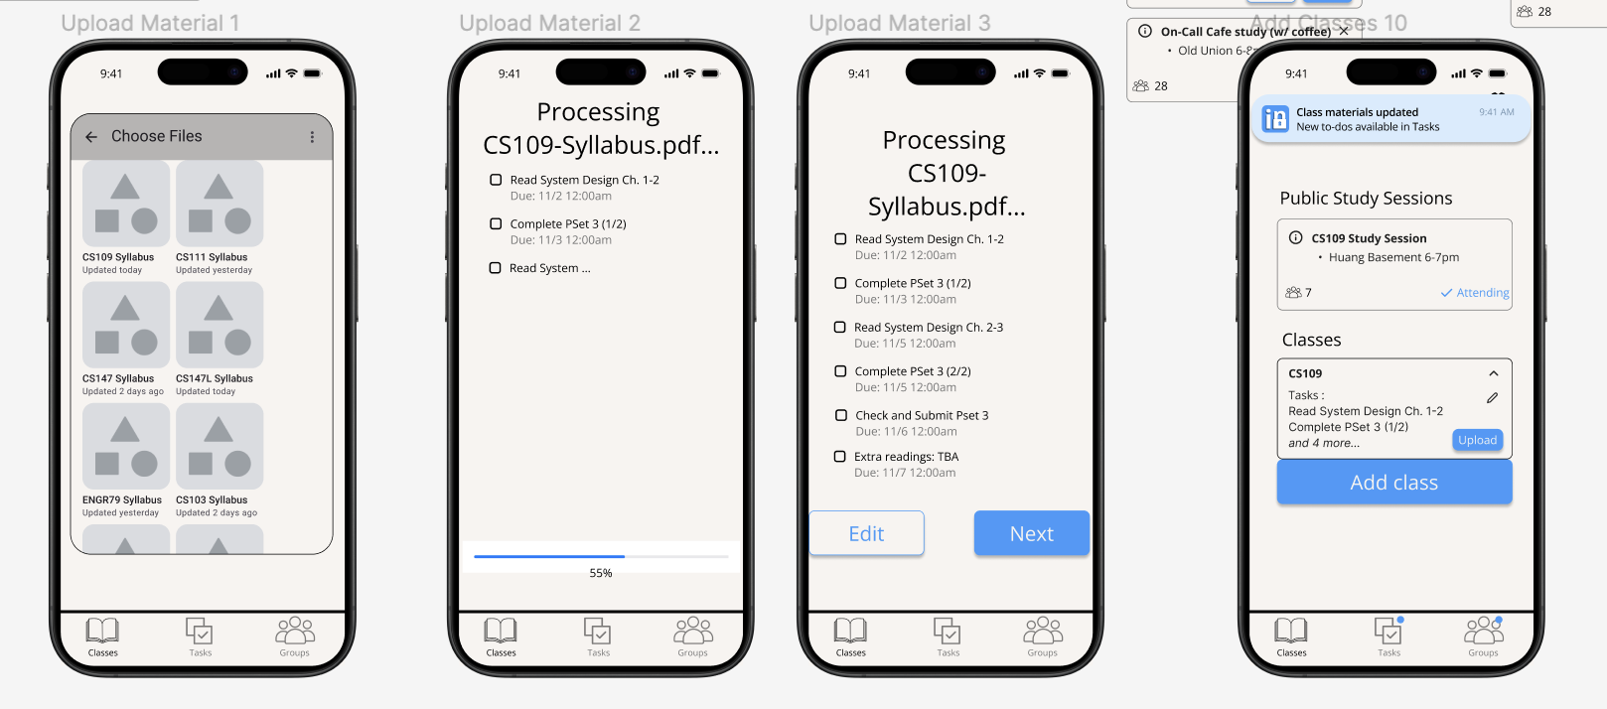
Use AI Powered Tool to Organize Documents

Slide 34
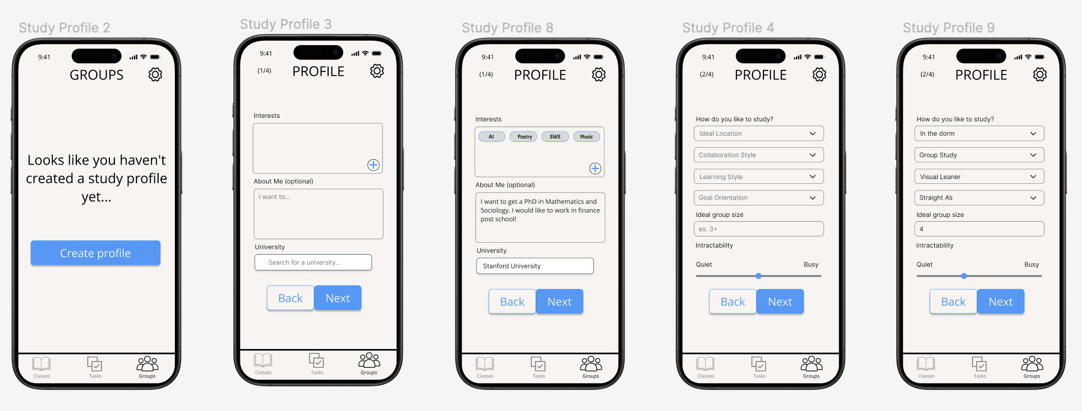
Create Study Profile and Match with Classmates

Slide 35
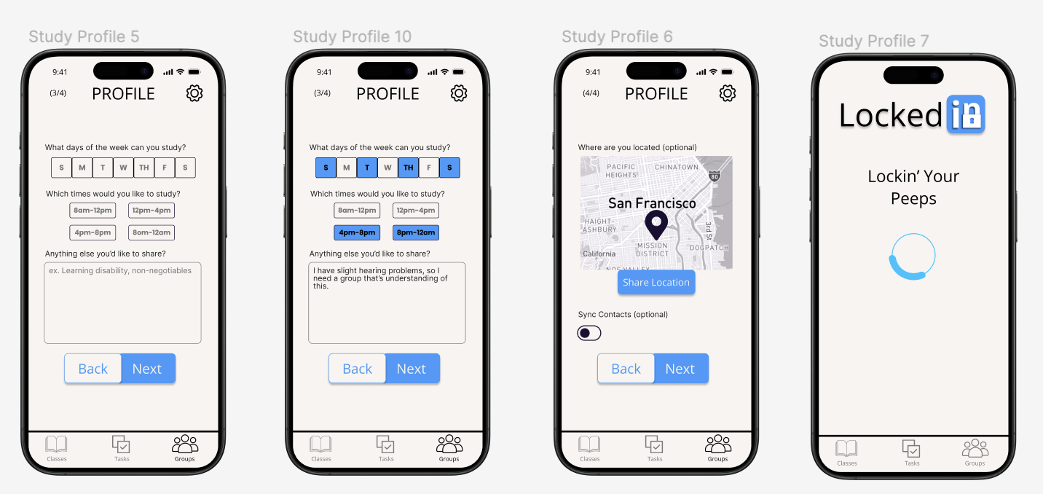
Create Study Profile and Match with Classmates

Slide 36
7.5 Expert Feedback
1
Whitespace: too much at the top, footer is a bit too large
2
Onboarding process should be visually distinct and more aesthetic
3
Need a consistent page title format
4
Would be nice to see all public study sessions before selecting class

Slide 37
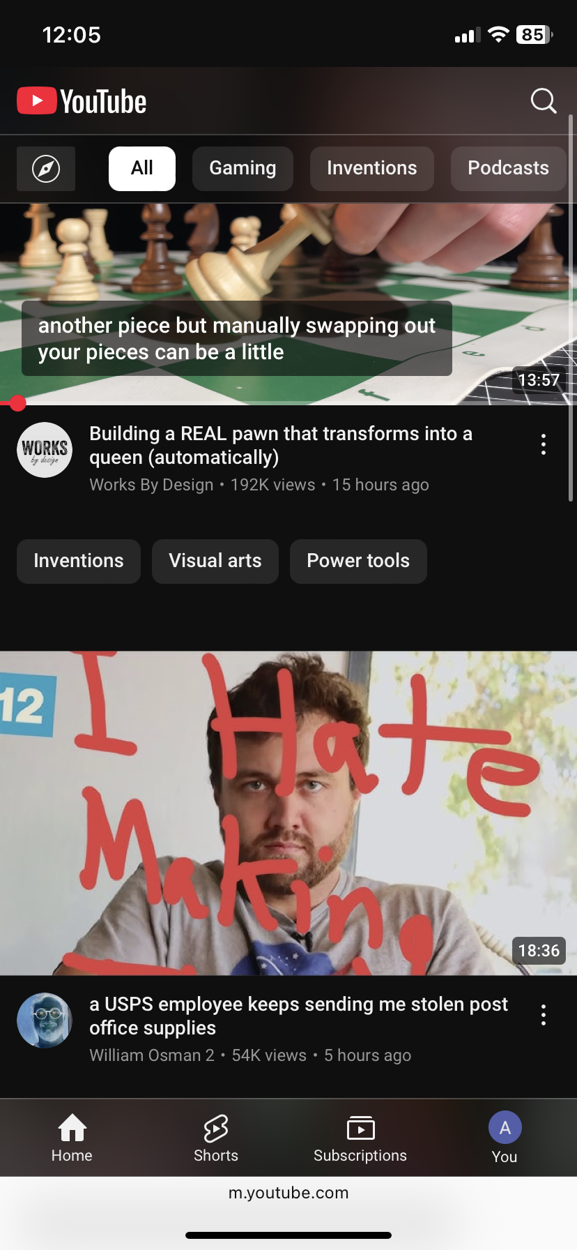
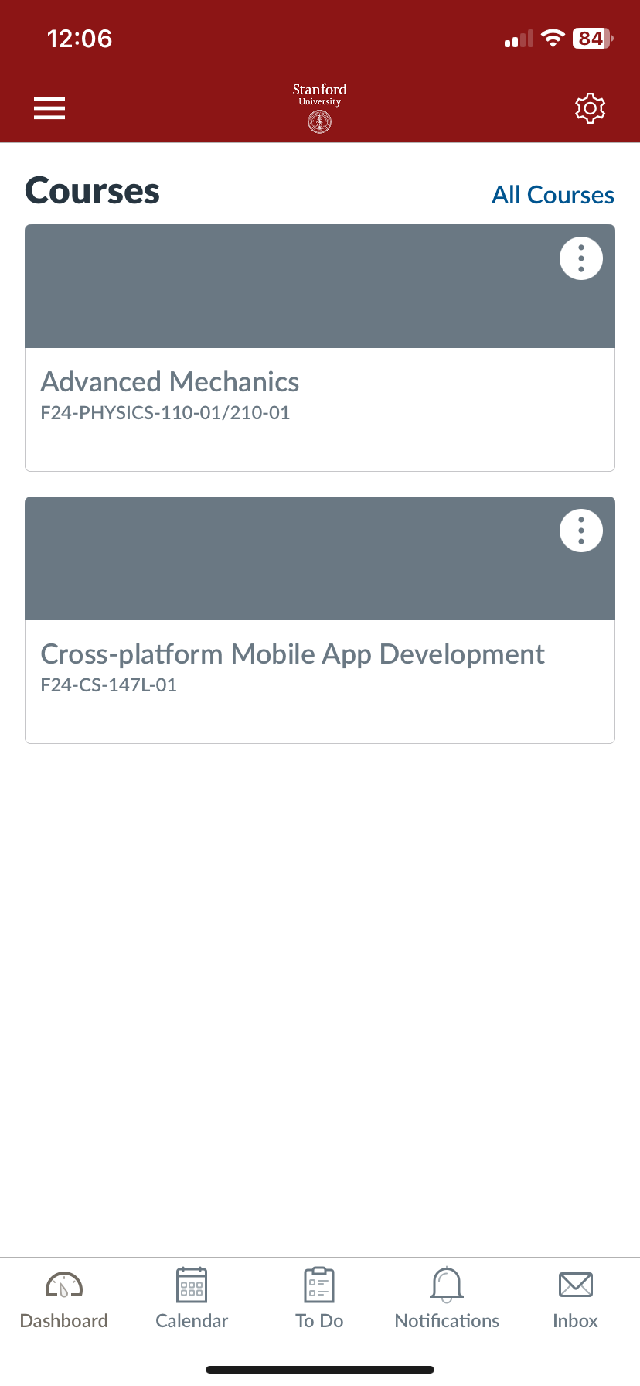
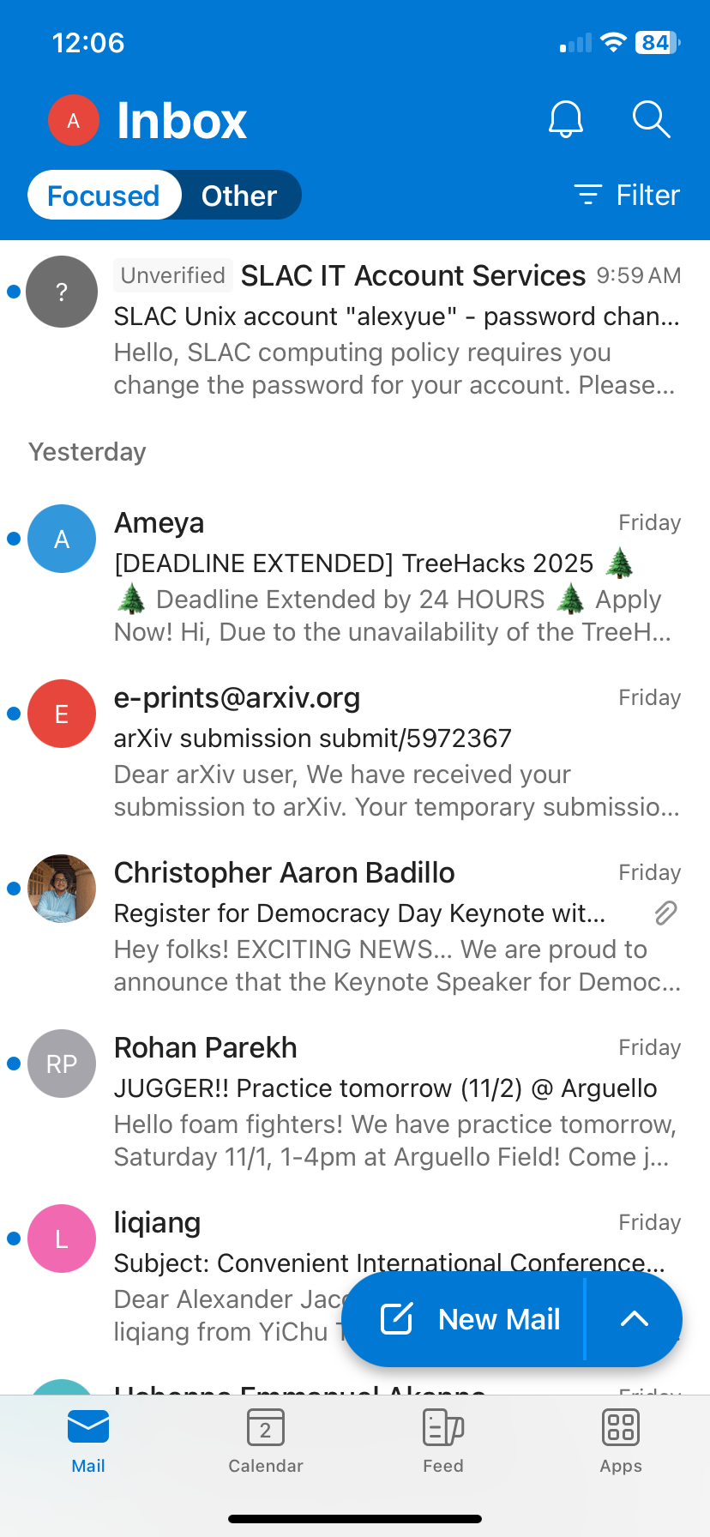
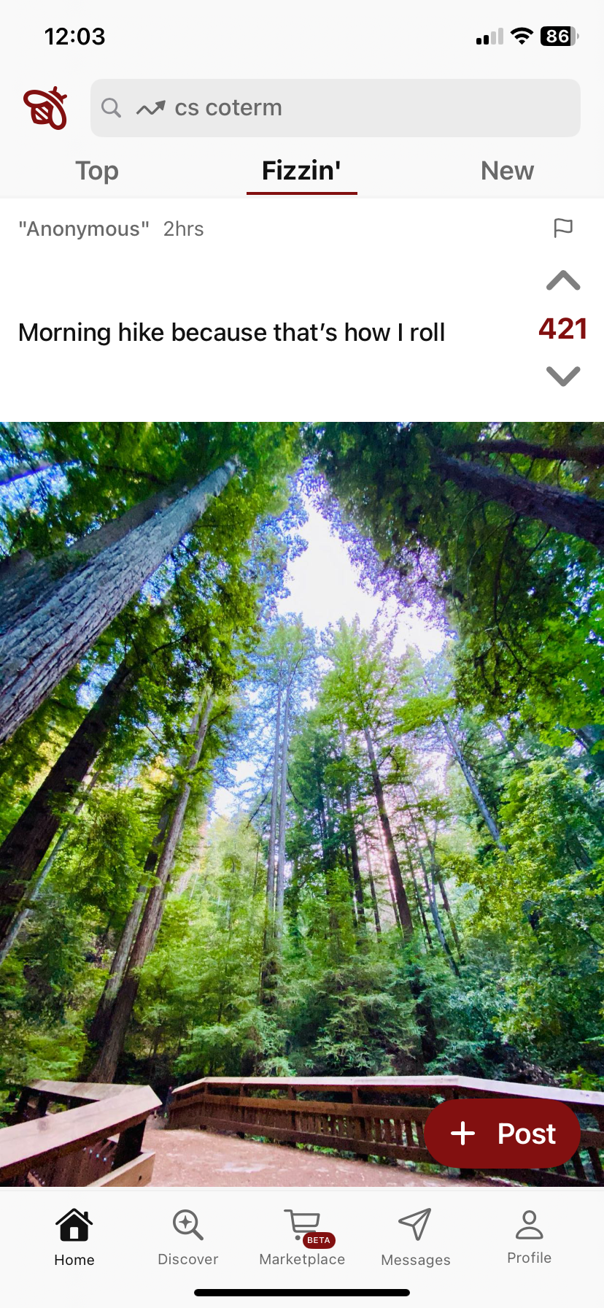
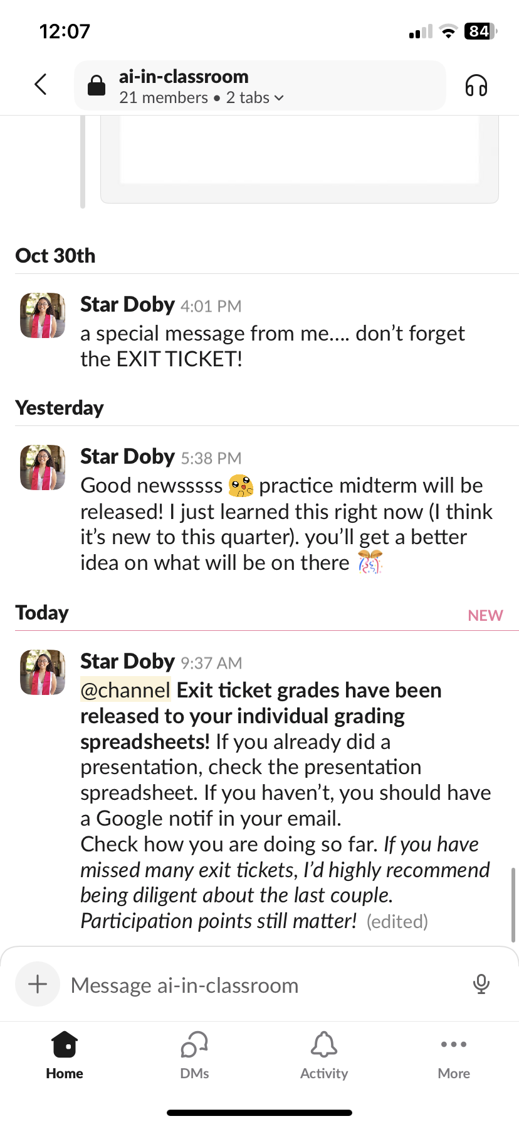
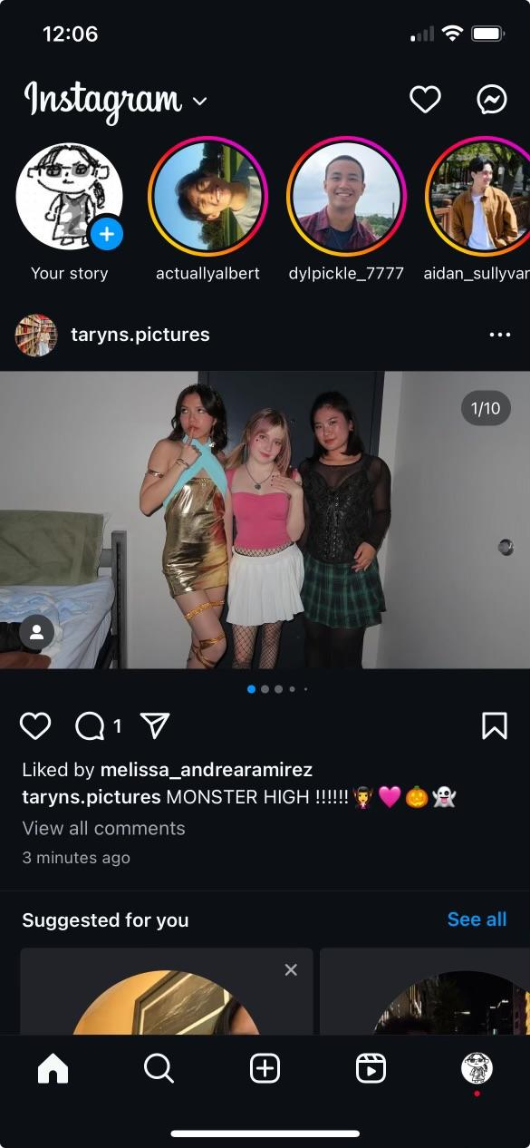
1
Whitespace: too much at the top, footer is a bit too large
Industry standard review:

Slide 38
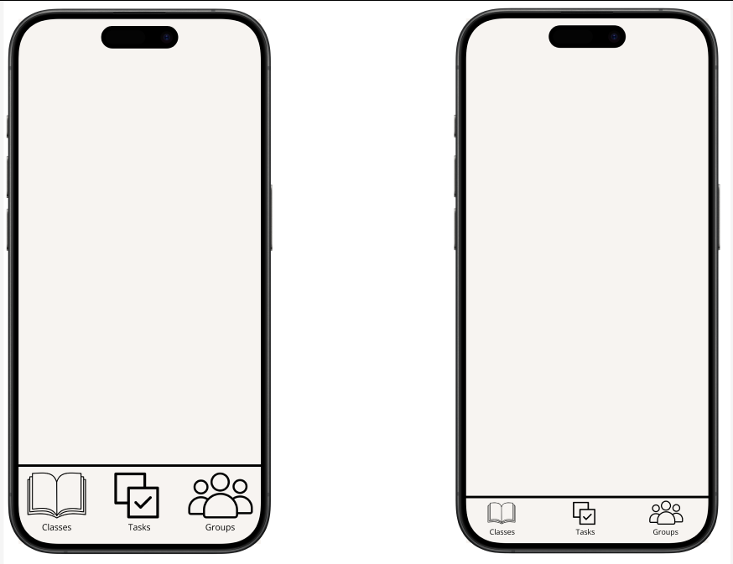
1
Whitespace: too much at the top, footer is a bit too large

Slide 39
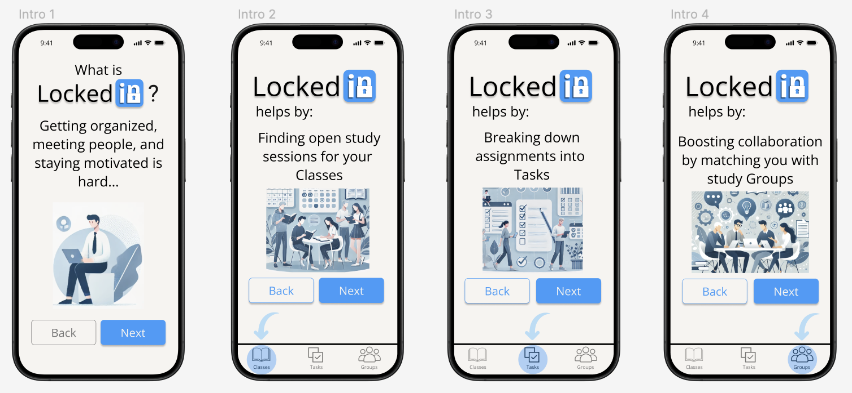
2
Onboarding process should be visually distinct and more aesthetic
We plan to make the onboarding more interactive and exciting in the high-fidelity version when we have more tools, but for now we added some images:

Slide 40
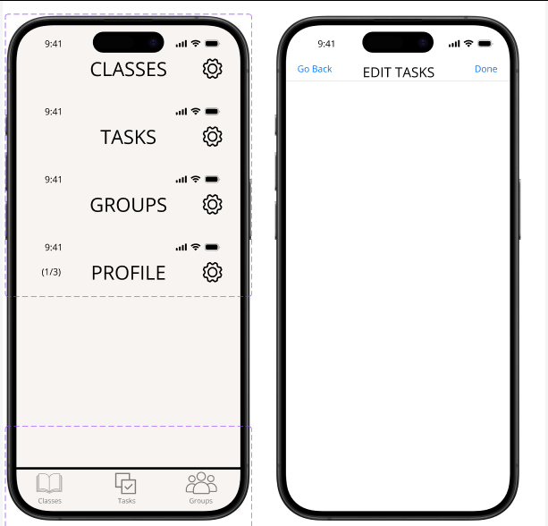
3
Need a consistent page title format

Slide 41
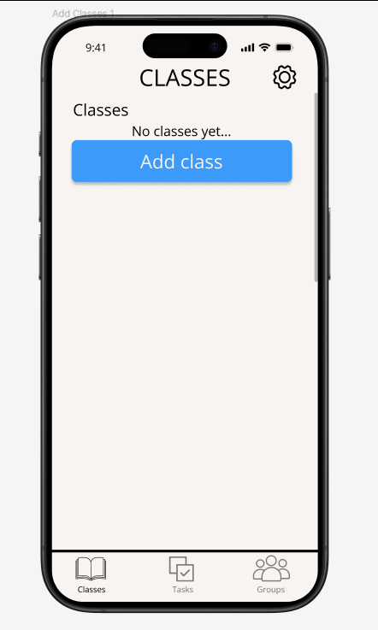
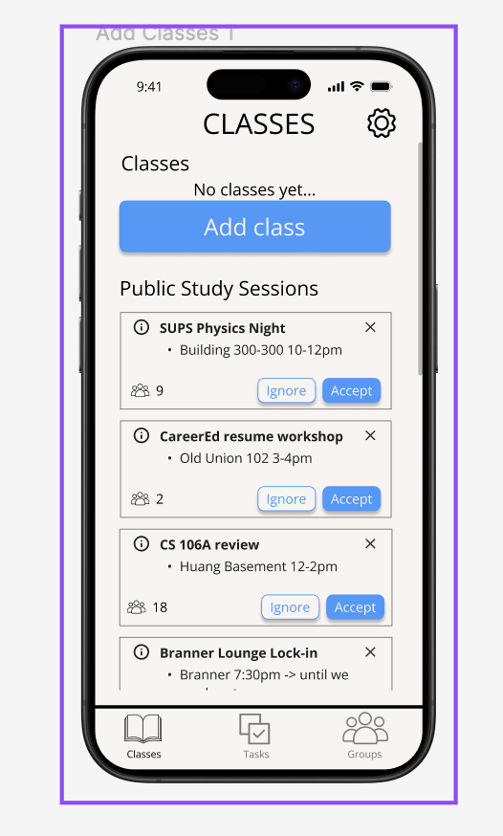
4
Would be nice to see all public study sessions before selecting class

Slide 42
08
PROTOTYPE IMPLEMENTATION

Slide 43

Design Tools
Notability
For brainstorming ideas, initial sketches of interfaces/logos, and task flows we used Notability
Pros
Great canvas for creative explorations
Easy to iterate and make changes
Simple and intuitive
Cons
Difficult to work on the same file, more like individual work and then sharing ideas together
Lack of wireframing
Lack of community and presets
Notes:
HMW’s Generated: 1. HMW... make opening up to other students less confrontational?
2. HMW... encourage collaboration amongst students with similar academic goals?
3. HMW... make connecting with other students fun, welcoming and productive?
4. HMW make resources easier to share/create a culture of sharing?
5. HMW eliminate the fear of reaching out to other students and sharing resources?
6. HMW... help students how to navigate their applications more effectively?
7. HMW create a more welcoming space for high school students working on college applications?
8. HMW create a more transparent system to show students what college admissions officers look for in students?
9. HMW... gameify application processes so they are more rewarding?
10. HMW ensure students are equipped with the best college app resources without the need for peer interaction?

Slide 44

Prototyping Tools
Figma
For designing mockups and prototyping, we used Figma
Pros
Group collaboration was great, allowed us to all work in unison
Reusable components extremely useful
Grid system helped a lot for alignment
Large community, lots of resources and templates
Cons
Learning curve to designing clean interfaces
No stored memory needed variations of screens for different interactions
Interactables increased in complexity the more screens there were
Notes:
HMW’s Generated: 1. HMW... make opening up to other students less confrontational?
2. HMW... encourage collaboration amongst students with similar academic goals?
3. HMW... make connecting with other students fun, welcoming and productive?
4. HMW make resources easier to share/create a culture of sharing?
5. HMW eliminate the fear of reaching out to other students and sharing resources?
6. HMW... help students how to navigate their applications more effectively?
7. HMW create a more welcoming space for high school students working on college applications?
8. HMW create a more transparent system to show students what college admissions officers look for in students?
9. HMW... gameify application processes so they are more rewarding?
10. HMW ensure students are equipped with the best college app resources without the need for peer interaction?

Slide 45
Limitations and Trade-Offs
What was left out of the prototype?
For designing mockups and prototyping, we used Figma
Users can’t input their own information for account or profile information
Requires a storage system which hasn’t been implemented and won’t be until high-fi prototype
Users have to follow the interactions we’ve designed for them
Leads to less exploration of class searches or file uploads
While users are free to click between designated screens, they have to complete tasks sequentially before doing so
Users can’t edit their profile after its initial creation
Not part of a major task flow, more for high-fi prototype
Interactions with matches are mocked, no intractability here
Requires storage system… we assume initial interactions
Notes:
HMW’s Generated: 1. HMW... make opening up to other students less confrontational?
2. HMW... encourage collaboration amongst students with similar academic goals?
3. HMW... make connecting with other students fun, welcoming and productive?
4. HMW make resources easier to share/create a culture of sharing?
5. HMW eliminate the fear of reaching out to other students and sharing resources?
6. HMW... help students how to navigate their applications more effectively?
7. HMW create a more welcoming space for high school students working on college applications?
8. HMW create a more transparent system to show students what college admissions officers look for in students?
9. HMW... gameify application processes so they are more rewarding?
10. HMW ensure students are equipped with the best college app resources without the need for peer interaction?

Slide 46
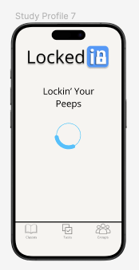
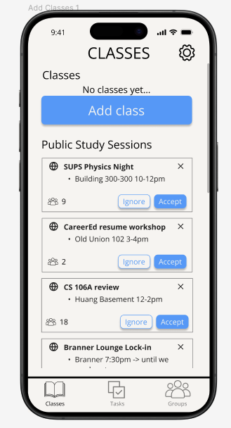
Wizard-of-Oz Features
What features were simulated?
AI Matching
Home Feed
[AI matching system assumed to be implemented and capable of matching]
[Feed system assumed to be working and collecting information from other users]
Notes:
HMW’s Generated: 1. HMW... make opening up to other students less confrontational?
2. HMW... encourage collaboration amongst students with similar academic goals?
3. HMW... make connecting with other students fun, welcoming and productive?
4. HMW make resources easier to share/create a culture of sharing?
5. HMW eliminate the fear of reaching out to other students and sharing resources?
6. HMW... help students how to navigate their applications more effectively?
7. HMW create a more welcoming space for high school students working on college applications?
8. HMW create a more transparent system to show students what college admissions officers look for in students?
9. HMW... gameify application processes so they are more rewarding?
10. HMW ensure students are equipped with the best college app resources without the need for peer interaction?

Slide 47
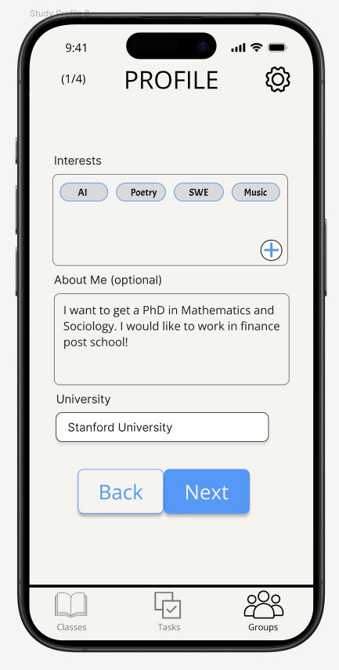
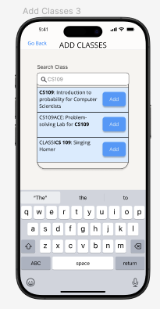
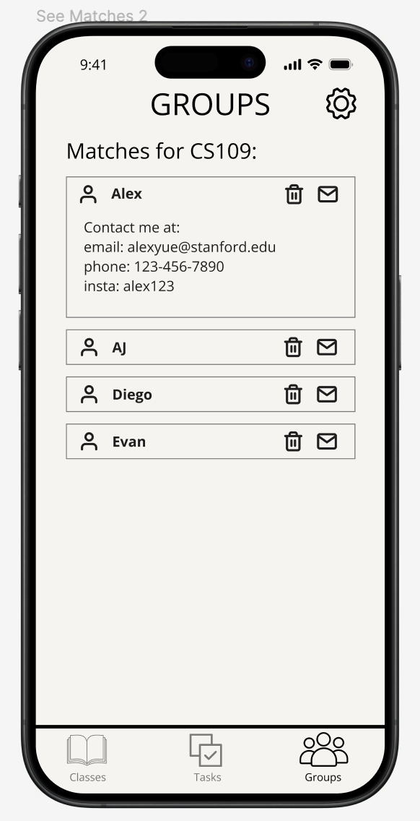
Hard-Coded Features
What features did we pre-set?
Users can’t change their personal information when creating a profile, add their concerns, ‘activate’ other features
Limited personalization for flexibility and additional concerns
Users can’t change the information used in searching or adding classes
We follow a scripted interaction that limits exploration of how these features intend to work
Similar for uploading documents to the AI algorithm
Users can’t interact with other matches, contacts are hardcoded and no actual interaction features
However, this was not required to test prototype flows
User information
Searching & Uploading
Contact Info
Notes:
HMW’s Generated: 1. HMW... make opening up to other students less confrontational?
2. HMW... encourage collaboration amongst students with similar academic goals?
3. HMW... make connecting with other students fun, welcoming and productive?
4. HMW make resources easier to share/create a culture of sharing?
5. HMW eliminate the fear of reaching out to other students and sharing resources?
6. HMW... help students how to navigate their applications more effectively?
7. HMW create a more welcoming space for high school students working on college applications?
8. HMW create a more transparent system to show students what college admissions officers look for in students?
9. HMW... gameify application processes so they are more rewarding?
10. HMW ensure students are equipped with the best college app resources without the need for peer interaction?

Slide 48
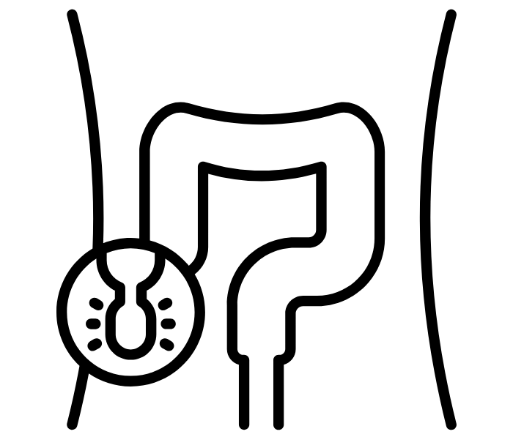
09
APPENDIX

Slide 49
Link to Figma
https://www.figma.com/proto/OCFo0SgSrsXFMxZrXMB7Am/LockedIn-Med-Fi-Prototype?node-id=0-1&t=8s75gByDfe2TJ0c0-1

